Slide 1
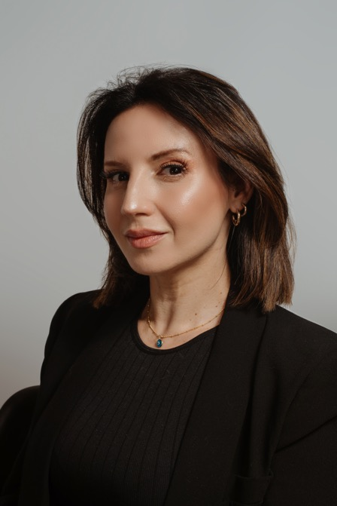
Nina Hastie
Actress | TV Personality | Voice Over Artist | Comedian | Emcee
Comedy is her flagship - but there is a fleet of expertise behind the pint-sized Nina Hastie.
She’s an accomplished writer, voice artist, actor, and director.
Her most recent achievements include:
DStv Content Creator Awards Nominee for “Best Content Creator” (2022)
DStv Viewers Choice Awards Nominee for “Favourite Comedian” (2022)
A Netflix Original Stand-Up Comedy show “Only Jokes Allowed” (2021)
Lead in the MNet Original Drama Series “Inconceivable” (2020)
Hastie presented on the SAFTA nominated SABC3 talk show “Trending SA” (2016-2019)
She also has a SAFTA nomination for “Writing in TV Comedy” (2016)
A Comic’s Choice Award nomination for “Comic’s Pen” (2015)
Head comedy writer for NBC Universal’s “Celebrity Game Night” (2019 - 2022)
Nina has hosted a variety of award shows over the years:
Assegai Awards (2019, 2020 & 2022)
SATMA Awards (2019 & 2020)
JSE Awards (2019)
SA Hip Hop Awards (2016, 2017)
Hastie is currently writing and directing the DStv Content Creator Awards.
Her curiosity with the social anthropology of South Africa, coupled with her empathetic nature makes for a unique personality both on and off stage.
She’s a powerful individual with the courage of intentional public vulnerability - and is about as authentic as they come. What you see is what you get.
And what you get is a class act, with 20 years of experience under her belt.
She is comfortable in any room and on any stage. She’s performed for Presidents and CEO’s, in boardrooms and bars. If she had a dime for every person who told her that their granny loves her - she’d have lots of dimes.
The 39 year old Nina Hastie is a beloved and trusted public personality.

